Slide 1

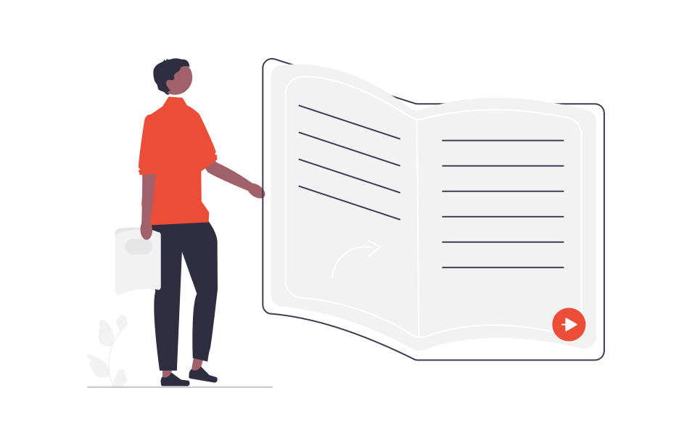
Learn CSS
CSS3 stands for Cascading Style Sheet level 3, which is the advanced version of CSS. It is used for structuring, styling, and formatting web pages.CSS3 includes some new features, like new CSS3 selectors, rounded corners, box shadows, RGBA, HSL and HSLA colors, box sizing, Opacity, CSS3 Gradients, transitions, transformations, animations, multi-column layout, flex box, CSS grids, embedded fonts and Responsive web design
02

Slide 2
Introduction
CSS stands for Cascading Style Sheets.
CSS describes how HTML elements are to be displayed on screen, paper, or in other media
CSS saves a lot of work. It can control the layout of multiple web pages all at once.
External stylesheets are stored in CSS files
Some properties in CSS 3
text-align: left / center / right / justify;
color: green;
border: 1px solid red;
font-size: 1rem;
font-weight: bold;
width: 100%;
height: 300px;
border-collapse: collapse;
border-radius: 10px;
cursor: pointer/ help /progress/text/s-resize/e-resize/ w-resize
Selector
Value
p { Color : Red ; }
Property
/* This is a single-line comment */

Slide 3
CSS Selectors
CSS selectors are used to "find" (or select) the HTML elements you want to style. We can divide CSS selectors into five categories:
Simple selectors (select elements based on name, id, class)
Combinator selectors (select elements based on a specific relationship between them)
Pseudo-class selectors (select elements based on a certain state)
Pseudo-elements selectors (select and style a part of an element)
Attribute selectors (select elements based on an attribute or attribute value)
Simple Selectors
CSS Element Selector
CSS Id Selector
CSS Class Selector
CSS Grouping Selector
CSS Universal Selector
P
{
color: red;
}

Slide 4
CSS Selectors
Combinator selectors
Universal Selector
*{
margin: 0px;
box-sizing:border-box;
}
Id Selector
<p id ="new"> Hello </p>
#new{
color:green;
}
Descendant Selector
div p img{
text-align: center;
}
Child Selector (>)
div>p {
text-align: center;
}
Grouping Selector
<div class ="demo">
<h1> Hello </h1>
<p> World </p>
</div>
div, h1, p{
color:green;
}
Class Selector
<p class ="demo"> Hello </p>
.demo{
color:green;
}
Adjacent Sibiling Selector (+)
div+p {
text-align: center;
}

Slide 5
CSS Selectors
General Subiling Selector (~)
<p id ="new">
<a href=”#”>hello</a>
</p>
p~a{
color:green;
}
Pseudo Class Selector
<a href="">Home </a>
a:hover{
color: yellow;
}
a:link - a normal, unvisited link
a:visited - a link the user has visited
a:hover - a link when the user mouses over it
a:active - a link the moment it is clicked

Slide 6
CSS Selectors
Pseudo Element Selector
Attribute Selector
<h1>This is element selector.</a>
a::after{
content:url(emoji.gif);
}
<input type="text">
input[text="text"]{
content:url(emoji.gif);
}
::before ::marker :used for lists
::first-line
::first-letter etc.
Search more Pseudo elements, pseudo class

Slide 7

1. Use of some css properties.
2. Use all types of selectors with examples.
Assignment 1:

Slide 8
Types of CSS
Using CSS
CSS can be added to HTML documents in 3 ways:
Inline - by using the style attribute inside HTML elements
Internal - by using a <style> element in the <head> section
External - by using a <link> element to link to an external CSS file
Inline CSS
An inline CSS is used to apply a unique style to a single HTML element.
An inline CSS uses the style attribute of an HTML element.
e.g.
<h1 style="color:blue;">A Blue Heading</h1>
<p style="color:red;">A red paragraph.</p>

Slide 9
Types of CSS
Internal CSS
<!DOCTYPE html>
<html>
<head>
<style>
body {background-color: powderblue;}
h1 {color: blue;}
</style>
</head>
<body>
<h1>This is a heading</h1>
</body>
</html>
An internal CSS is used to define a style for a single HTML page.
An internal CSS is defined in the <head> section of an HTML page, within a <style> element.
e.g.

Slide 10
Types of CSS
External CSS
index.html
<!DOCTYPE html>
<html>
<head>
<link rel="stylesheet" href="style.css">
</head>
<body>
<h1>This is a heading</h1>
<p>This is a paragraph.</p>
</body>
</html>
An external style sheet is used to define the style for many HTML pages.
To use an external style sheet, add a link to it in the <head> section of each HTML page:
style.css
body {
background-color: powderblue;
}
h1 {
color: blue;
}

Slide 11
Color
CSS RGB and RGBA Colors
RGBA color values are an extension of RGB color values with an Alpha channel - which specifies the opacity for a color.
rgba(red, green, blue, alpha)
The alpha parameter is a number between 0.0 (fully transparent) and 1.0 (not transparent at all):
e.g.
rgba(255, 99, 71, 1)
An RGB color value represents RED, GREEN, and BLUE light sources.
An RGBA color value is an extension of RGB with an Alpha channel (opacity). rgb(red, green, blue)
Each parameter (red, green, and blue) defines the intensity of the color with a value between 0 and 255.
e.g.
rgb(255, 0, 0)

Slide 12
Color
CSS Colors
In HTML, a color can be specified using hue, saturation, and lightness (HSL) in the form:
hsl(hue, saturation, lightness)
Hue is a degree on the color wheel from 0 to 360. 0 is red, 120 is green, and 240 is blue.
Saturation is a percentage value. 0% means a shade of gray, and 100% is the full color.
Lightness is also a percentage value. 0% is black, and 100% is white.
A hexadecimal color is specified with: #RRGGBB, where the RR (red), GG (green) and BB (blue) hexadecimal integers specify the components of the color.
Where rr (red), gg (green) and bb (blue) are hexadecimal values between aa and ff (same as decimal 0-9).
<h1 style="color:#404040;">#404040</h1>
e.g.
#f f f; OR #f f f f f f;
and with opacity
#f f f f f f 80;

Slide 13
Background
The CSS background properties are used to add background effects for elements.
you will learn about the following CSS background properties:
background-color: red;
background-size: 100px 80px / contain/ cover;
background-image: url("bgdesert.jpg");
background-repeat: repeat-x/ repeat-y/no-repeat;
background-attachment: fixed/ scroll;
background-position: right top;
background (shorthand property)
background: #ffffff url("img_tree.png") no-repeat right top;
Button
<button class="button">Green</button>
.button {
background-color: #4CAF50;
border: none;
color: white;
padding: 15px 32px;
text-align: center;
text-decoration: none;
display: inline-block;
font-size: 16px;
margin: 4px 2px;
cursor: pointer;
border-radius: 2px;
box-shadow: 0 8px 16px 0 rgba(0,0,0,0.2), 0 6px 20px 0 rgba(0,0,0,0.19);
}

Slide 14
1. Desing a simple web page using different types of css style.
2. Ues of different types of color methods with examples.
Assignment 2:

Slide 15
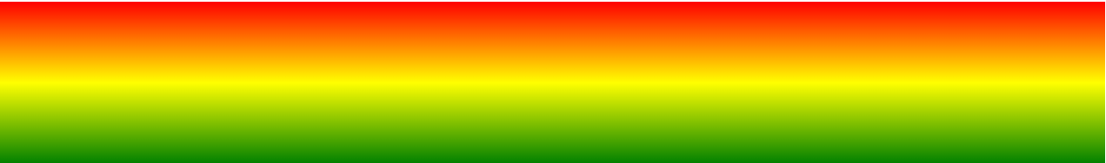

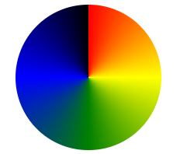
Gradient Color
CSS gradients let you display smooth transitions between two or more specified colors.
CSS defines three types of gradients:
Linear Gradients (goes down/up/left/right/diagonally)
Radial Gradients (defined by their center)
Conic Gradients (rotated around a center point)

Slide 16

Gradient Color
Linear Gradient
background-image: linear-gradient(red, yellow);
background-image: linear-gradient(to right, red , yellow);
background-image: linear-gradient(180deg, red, yellow);

Slide 17
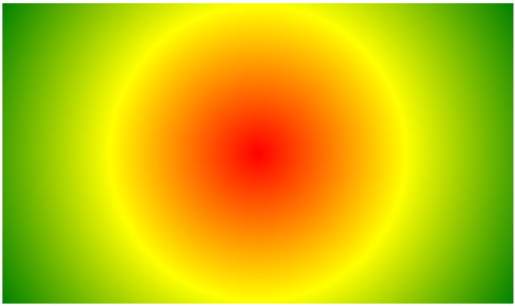
Gradient Color
Radial Gradient
background-image: radial-gradient(red, yellow, green);
background-image: radial-gradient(red 5%, yellow 15%, green 60%);
background-image: radial-gradient(circle, red, yellow, green);

Slide 18
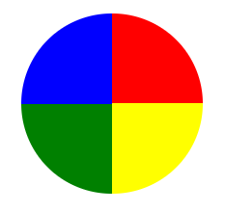
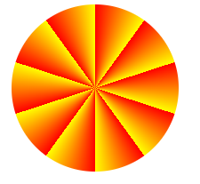
Gradient Color
Conic Gradient
background-image: conic-gradient(red, yellow, green); border-radius: 50%;
background-image: conic-gradient(red 0deg, red 90deg, yellow 90deg, yellow 180deg, green 180deg, green 270deg, blue 270deg);
background-image: repeating-conic-gradient(red 10%, yellow 20%);
border-radius: 50%;

Slide 19
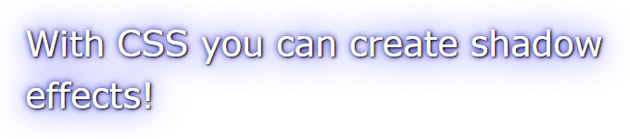
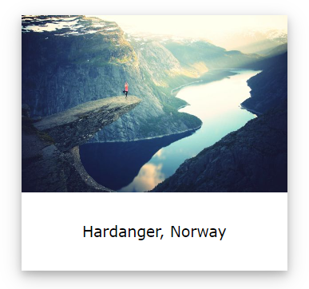
CSS Shadow Effects
With CSS you can add shadow to text and to elements.
In these chapters you will learn about the following properties:
text-shadow
h1 {
color: white;
text-shadow: 2px 2px 4px #000000;
}
box-shadow
div {
box-shadow: 10px 10px 5px lightblue;
}

Slide 20
CSS object-fit
The CSS object-fit property is used to specify how an <img> or <video> should be resized to fit its container.
object-fit: cover/ contain/ fill/ none;
position: static;
HTML elements are positioned static by default.
position: fixed;
An element with position: fixed; is positioned relative to the viewport, which means it always stays in the same place even if the page is scrolled.
The top, right, bottom, and left properties are used to position the element.
position: fixed;
CSS Position Property
The position property specifies the type of positioning method used for an element (static, relative, fixed, absolute or sticky).

Slide 21
CSS Position Property
position: sticky;
An element with position: sticky; is positioned based on the user's scroll position.
div.sticky {
position: sticky;
top: 0;
}
position: relative;
An element with position: relative; is positioned relative to its normal position.
div.relative {
position: relative;
left: 30px;
}

Slide 22
CSS Position Property
div.relative {
position: relative;
width: 400px;
height: 200px;
border: 3px solid #73AD21;
}
div.absolute {
position: absolute;
top: 80px;
right: 0;
width: 200px;
height: 100px;
}
position: absolute; An element with position: absolute; is positioned relative to the nearest positioned ancestor (instead of positioned relative to the viewport, like fixed).

Slide 23
1. Desing a simple web page using different types of css gradient color methods.
2. Use of show effect.
3. Use of position property properly with examples.
Assignment 3:

Slide 24
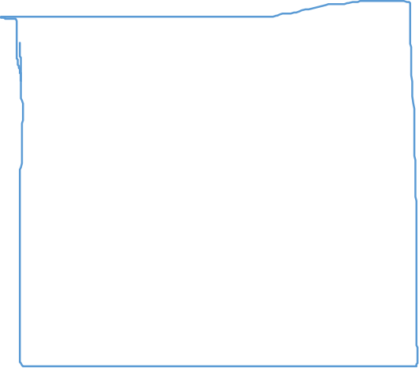

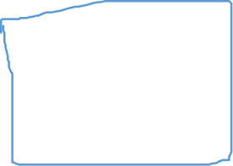

CSS Box Model
In CSS, the term "box model" is used when talking about design and layout.
The CSS box model is essentially a box that wraps around every HTML element. It consists of: margins, borders, margin, and the actual content. The image below illustrates the box model:
Content - The content of the box, where text and images appear
padding- Clears an area around the content. The margin is transparent
Border - A border that goes around the margin and content
Margin - Clears an area outside the border. The margin is transparent
Content
padding
Border
Margin

Slide 25







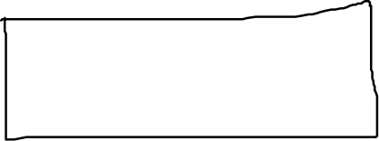
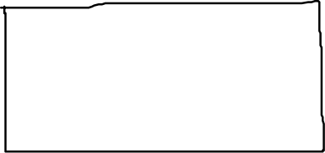
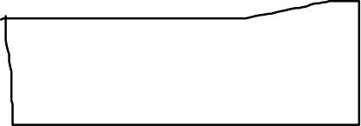
CSS Box Model
Padding
padding:14px; # top, left, right, and left
padding: 14px 16px; # top & bottom, and right & left
padding: 14px 16px 18px; # top , right and bottom;
padding: 14px 16px 18px 20px; # top, left, right, and left;
padding-top: 14px; # top
Content
Content
Content

Slide 26









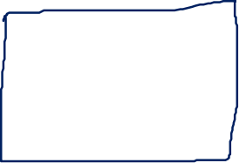




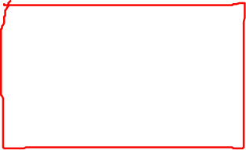
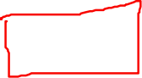
CSS Box Model
Margin
content
margin:14px; # top, left, right, and left
margin: 14px 16px; # top & bottom, and right & left
margin: 14px 16px 18px; # top , right and bottom;
margin: 14px 16px 18px 20px; # top, left, right, and left;
margin-top: 14px; # top
content
content

Slide 27

Website Layout
<header> - Defines a header for a document or a section
<nav> - Defines a set of navigation links
<section> - Defines a section in a document
<article> - Defines an independent, self-contained content
<aside> - Defines content aside from the content (like a sidebar)
<footer> - Defines a footer for a document or a section
<header>
<nav>
<section>
<aside>
HTML Layout Techniques
There are four different techniques to create multicolumn layouts. Each technique has its pros and cons:
CSS framework
CSS float property
CSS flexbox
CSS grid
<article>
footer

Slide 28








Website Layout : Float Property
first
First
First
Second
second
Second
Responsive in large device
Media Query
After responsive in Mobile
Use Float property

Slide 29

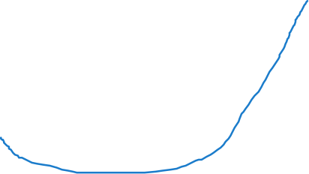
Website Layout : Float Property
<!DOCTYPE html>
<html lang="en">
<head>
<title>CSS Template</title>
<meta charset="utf-8">
<meta name="viewport" content="width=device-width, initial-scale=1">
</head>
<body>
<h2>CSS Layout Float</h2>
<p>In this example, r.</p>
<p>Resize the browser wir - HTML Responsive.)</p>
<header>
<h2>Cities</h2>
</header>
<section>
<nav>
<ul>
<li><a href="#">London</a></li>
<li><a href="#">Paris</a></li>
</ul>
</nav>
Stype.css
* {
margin:0;
box-sizing: border-box;
}
body {
font-family: Arial, Helvetica, sans-serif;
}
/* Style the header */
header {
background-color: #666;
padding: 30px;
text-align: center;
font-size: 35px;
color: white;
}
<article>
<h1>London</h1>
<p>London is the capital city of </p>
<p>Standing on the River </p>
</article>
</section>
<footer>
<p>Footer</p>
</footer>
</body>
</html>

Slide 30


Website Layout : Float Property
/* Create two columns/boxes that floats next to each other */
nav {
float: left;
width: 30%;
height: 300px; /* only for demonstration, should be removed */
background: #ccc;
padding: 20px;
}
/* Style the list inside the menu */
nav ul {
list-style-type: none;
padding: 0;
}
article {
float: left;
padding: 20px;
width: 70%;
background-color: #f1f1f1;
height: 300px; /* only for demonstration, should be removed */
}
/* Clear floats after the columns */
section::after {
content: "";
display: table;
clear: both;
}
/* Style the footer */
footer {
background-color: #777;
padding: 10px;
text-align: center;
color: white;
}
/* Responsive */
@media (max-width: 600px) {
nav, article {
width: 100%;
height: auto;
}
}

Slide 31
1. Use of box model properly with example.
2. Design a portifolio landing page using float layout property.
Assignment 4:

Slide 32
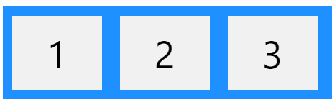
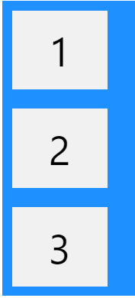
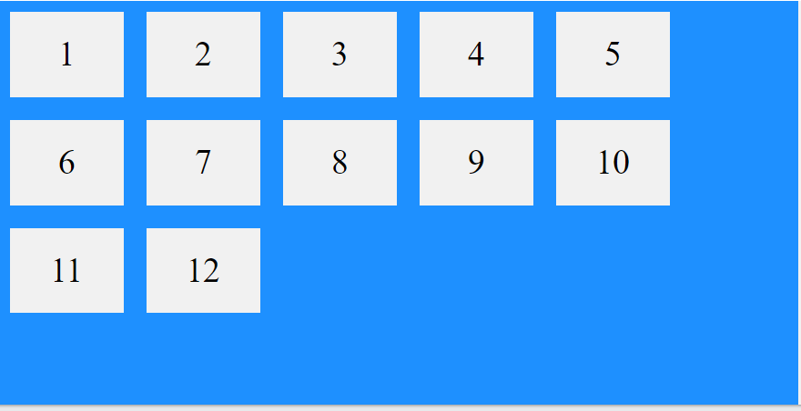
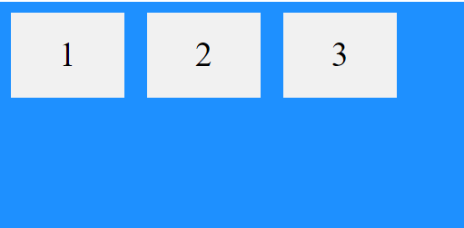






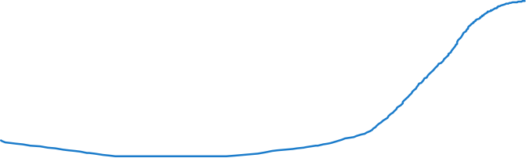



Website Layout : Flex layout
Flex properties are:
display: flex;
flex
flex-direction: column;
flex-wrap
flex-flow
flex-grow
flex-shrink
justify-content
align-items
align-content

Slide 33
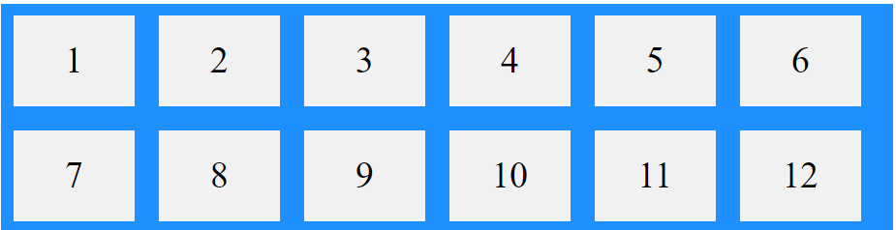
Website Layout : Flex layout
Flex properties are:
<div class="flex-container">
<div>1</div>
<div>2</div>
<div>3</div>
<div>4</div>
<div>5</div>
<div>6</div>
<div>7</div>
<div>8</div>
<div>9</div>
<div>10</div>
<div>11</div>
<div>12</div>
</div>
.flex-container {
display: flex;
flex-wrap: wrap;
background-color: DodgerBlue;
}
.flex-container > div {
flex: 1 1 400px;
background-color: #f1f1f1;
width: 100px;
margin: 10px;
text-align: center;
line-height: 75px;
font-size: 30px;
}

Slide 34
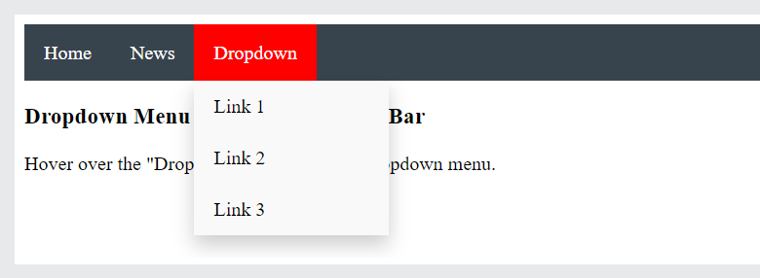
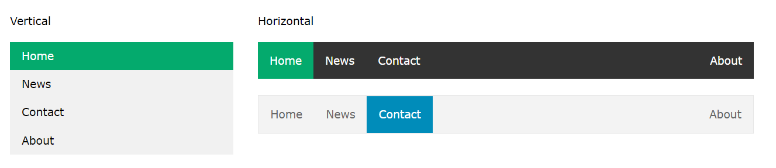
Navigation
Having easy-to-use navigation is important for any web site.
With CSS you can transform boring HTML menus into good-looking navigation bars.

Slide 35
Navigation
<ul>
<li><a class="active" href="#home">Home</a></li>
<li><a href="#news">News</a></li>
<li><a href="#contact">Contact</a></li>
<li><a href="#about">About</a></li>
</ul>
<div style="margin-left:25%;padding:1px 16px;height:1000px;">
<h2>Fixed Full-height Side Nav</h2>
<h3>Try to scroll this area, </h3>
<p>Some text..</p>
<p>Some text..</p>
<p>Some text..</p>
<p>Some text..</p>
<p>Some text..</p>
<p>Some text..</p>
<p>Some text..</p>
</div>
body {
margin: 0;
}
ul {
list-style-type: none;
margin: 0;
padding: 0;
width: 25%;
background-color: #f1f1f1;
position: fixed;
height: 100%;
overflow: auto;
}
li a {
display: block;
color: #000;
padding: 8px 16px;
text-decoration: none;
}
li a.active {
background-color: #04AA6D;
color: white;
}
li a:hover:not(.active) {
background-color: #555;
color: white;
}

Slide 36
1. Design a portifolio landing page using float layout property.
2. Design vertical and horizontal dropdown navigation.
Assignment 5:

Slide 37
Overflow, text, font, icon, outline
Overflow
div{
overflow: visible / hidden / auto / scroll;
}
text-decoration-color: red;
text-decoration-style: solid /double;
text-decoration-thickness: 5px;
text-decoration: none/ underline;
text-transform: uppercase/ lowercase;
text-indent: 60px;
letter-spacing: 2px;
line-height: 3;
word-spacing: 4px;
white-space: 1px;
text-shadow: 2px 2px 5px red;
outline: 1px solid green;
Text
color:red;
text-align: left/ center/ right/ justify;
text-align-last: right;
direction: rtl ;
vertical-align: text-top;
text-decoration-line: overline/ line-through/ underline;

Slide 38
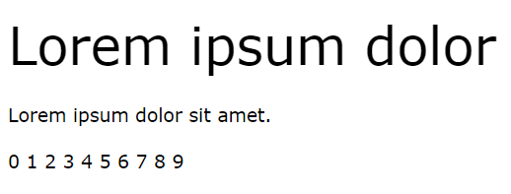
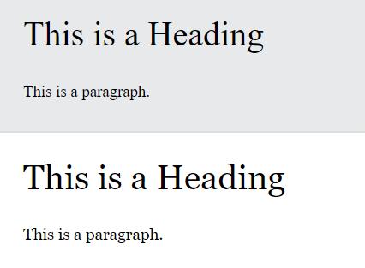
Overflow, text, font, icon
Font
div{
font-family:Sans-serif ;
}
https://fonts.google.com/
Web Safe Fonts
Arial (sans-serif)
Verdana (sans-serif)
Tahoma (sans-serif)
Trebuchet MS (sans-serif)
Times New Roman (serif)
Icon
div{
font-family:Sans-serif ;
}
https://fontawesome.com/icons
Font Fallbacks
Serif
Sans-serif
Monospace
Cursive
Fantasy

Slide 39
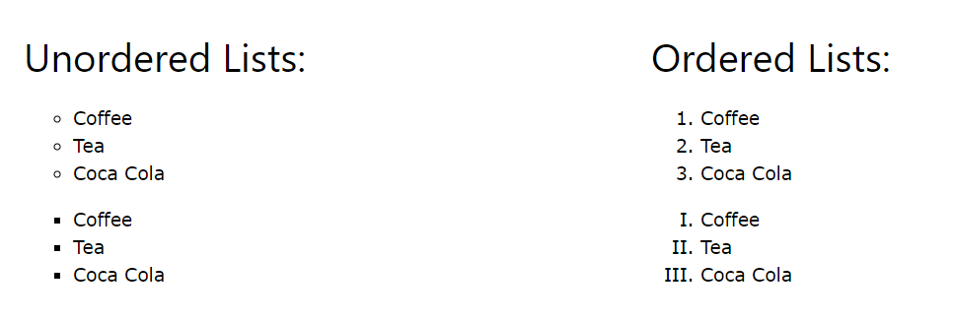
Lists
list-style-type: circle /circle/ square/ upper-roman;
list-style-image: url('sqpurple.gif');
list-style-position: outside/ inside;

Slide 40
z-index
! important
When elements are positioned, they can overlap other elements.
The z-index property specifies the stack order of an element (which element should be placed in front of, or behind, the others).
The !important rule in CSS is used to add more importance to a property/value than normal.
.myclass {
background-color: gray;
}
p {
background-color: red !important;
}
<p class="myclass">This is some text in a paragraph.</p>
The CSS math functions allow mathematical expressions to be used as property values. Here, we will explain the calc(), max() and min() functions.
img {
position: absolute;
left: 0px;
top: 0px;
z-index: -1;
}
<h1>This is a heading</h1>
<img src="img_tree.png">

Slide 41
1. Use of text style property, font , and icon with example.
2. Design menu of a restaurent using lists.
Assignment 6:

Slide 42
Table
<table>
<tr>
<th>Firstname</th>
<th>Lastname</th>
<th>Savings</th>
</tr>
<tr>
<td>Joe</td>
<td>Swanson</td>
<td>$300</td>
</tr>
<tr>
<td>Cleveland</td>
<td>Brown</td>
<td>$250</td>
</tr>
</table>
To specify table borders in CSS, use the border property.
The example below specifies a solid border for <table>, <th>, and <td> elements:
table, th, td {
border: 1px solid; //border
border-collapse: collapse; //collapse
}
table {
width: 100%; //table size
}
td {
height: 50px;
vertical-align: bottom; // alignment
}
table, td, th {
border: 1px solid #ddd;
text-align: left;
}
table {
border-collapse: collapse;
width: 100%;
}
th, td {
padding: 15px;
}

Slide 43
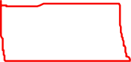
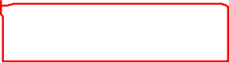



Display
The display property specifies if/how an element is displayed.
Every HTML element has a default display value depending on what type of element it is. The default display value for most elements is block or inline.
display: inline;
display: inline-block, the top and bottom margins/paddings are respected, but with display: inline they are not.
Compared to display: block, the major difference is that display: inline-block does not add a line-break after the element, so the element can sit next to other elements.
Width & Max-width
<div class="ex1">This div element has width: 500px;</div>
<div class="ex2">This div element has max-width: 500px;</div>
div.ex1 {
width: 500px;
margin: auto;
border: 3px solid #73AD21;
}
div.ex2 {
max-width: 500px;
margin: auto;
border: 3px solid #73AD21;
}
Mobile responsive

Slide 44
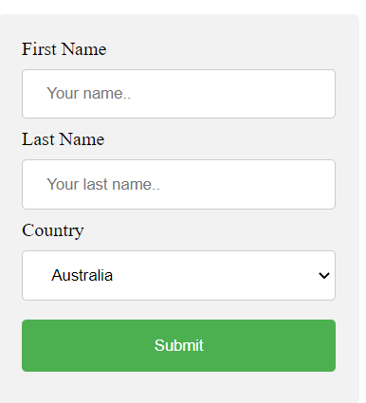
Form
input[type=text], select {
width: 100%;
padding: 12px 20px;
margin: 8px 0;
display: inline-block;
border: 1px solid #ccc;
border-radius: 4px;
box-sizing: border-box;
}
input[type=submit] {
width: 100%;
background-color: #4CAF50;
color: white;
padding: 14px 20px;
margin: 8px 0;
border: none;
border-radius: 4px;
cursor: pointer;
}
input[type=submit]:hover {
background-color: #45a049;
}
div {
border-radius: 5px;
background-color: #f2f2f2;
padding: 20px;
}
<div>
<form action="/action_page.php">
<label for="fname">First Name</label>
<input type="text" id="fname" name="firstname" placeholder="Your name..">
<label for="lname">Last Name</label>
<input type="text" id="lname" name="lastname" placeholder="Your last name..">
<label for="country">Country</label>
<select id="country" name="country">
<option value="australia">Australia</option>
<option value="canada">Canada</option>
<option value="usa">USA</option>
</select>
<input type="submit" value="Submit">
</form>
</div>

Slide 45
1. Design a +2 transcript certificate using table, flex layout.
2. Design admission form, register form , and login form with attractive layout.
Assignment 7:

Slide 46
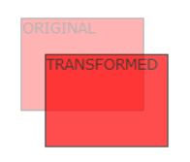
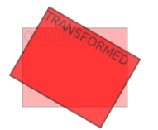
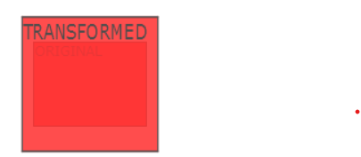
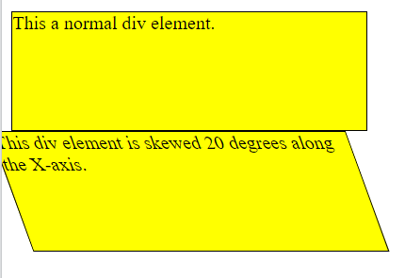







2D & 3D Animation
CSS 2D Transforms
CSS transforms allow you to move, rotate, scale, and skew elements.
Mouse over the element below to see a 2D transformation:
With the CSS transform property you can use the following 2D transformation methods:
translate() transform: translate(50px, 100px);
rotate() transform: rotate(20deg);
scaleX()
scaleY()
scale() transform: scale(2, 3);
skewX()
skewY()
skew() transform: skewX(20deg);
matrix()

Slide 47
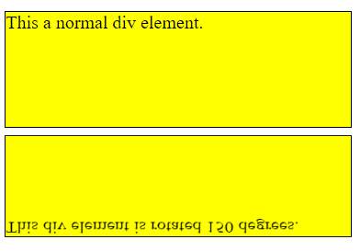
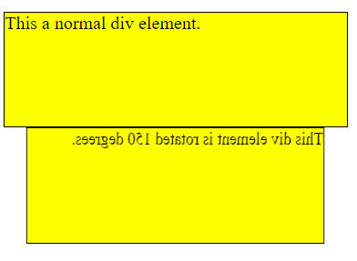
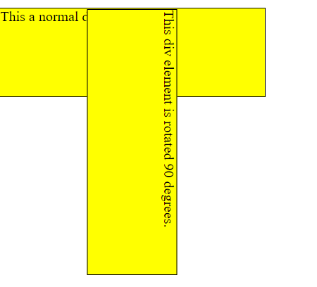
2D & 3D Animation
With the CSS transform property you can use the following 3D transformation methods:
rotateX() transform: rotateX(150deg);
rotateY() transform: rotateY(150deg);
rotateZ() transform: rotateZ(90deg);

Slide 48
Transitions
CSS transitions allows you to change property values smoothly, over a given duration.
Mouse over the element below to see a CSS transition effect:
you will learn about the following properties:
transition : 2s;
transition-delay: 3s;
transition-duration : 3s;
transition-property: width;
transition-timing-function: ease/ ease-in/ ease-out;
<div> </div>
div {
width: 100px;
height: 100px;
background: red;
transition: width 2s;
}
div:hover {
width: 300px;
}
transition: width 2s, height 2s, transform 2s;
div:hover {
width: 300px;
height: 300px;
transform: rotate(180deg);
}

Slide 49
Animation
CSS allows animation of HTML elements without using JavaScript or Flash!
you will learn about the following properties:
@keyframes
animation-name
animation-duration
animation-delay
animation-iteration-count
animation-direction
animation-timing-function
animation-fill-mode
animation
@keyframes example {
from {
background-color: red;
}
to {background-color: yellow;}
}
@keyframes example {
0% {background-color: red;}
25% {background-color: yellow;}
50% {background-color: blue;}
100% {background-color: green;}
}

Slide 50
Animation
<div></div>
div {
width: 100px;
height: 100px;
background-color: red;
animation-name: example;
animation-duration: 4s;
}
@keyframes example {
0% {background-color: red;}
25% {background-color: yellow;}
50% {background-color: blue;}
100% {background-color: green;}
}
<div class =”ani”></div>
.ani{
width: 100px;
height: 100px;
background-color: red;
position: relative;
animation-name: example;
animation-duration: 4s;
}
@keyframes example {
0% { background-color:red; left:0px; top:0px; }
25% { background-color:yellow; left:200px; top:0px; }
50% { background-color:blue; left:200px; top:200px; }
75% { background-color:green; left:0px; top:200px; }
100% { background-color:red; left:0px; top:0px; }
}

Slide 51
1. Design a web page using tansition property, 2D and 3D with animation.
Assignment 8:

Slide 52
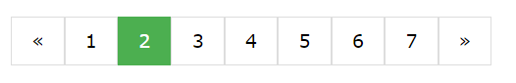
Pagination
.pagination {
display: inline-block;
}
.pagination a {
color: black;
float: left;
padding: 8px 16px;
text-decoration: none;
transition: background-color .3s;
border: 1px solid #ddd;
}
.pagination a.active {
background-color: #4CAF50;
color: white;
border: 1px solid #4CAF50;
}
.pagination a:hover:not(.active) {background-color: #ddd;}
<div class="pagination">
<a href="#">&laquo;</a>
<a href="#">1</a>
<a href="#">2</a>
<a href="#">3</a>
<a href="#">4</a>
<a href="#">5</a>
<a href="#">6</a>
<a href="#">&raquo;</a>
</div>

Slide 53
Media Query
.example {
padding: 20px;
color: white;
}
/* Extra small devices (phones, 600px and down) */
@media only screen and (max-width: 600px) {
.example {background: red;}
}
/* Small devices (portrait tablets and large phones, 600px and up) */
@media only screen and (min-width: 600px) {
.example {background: green;}
}
/* Medium devices (landscape tablets, 768px and up) */
@media only screen and (min-width: 768px) {
.example {background: blue;}
}
/* Large devices (laptops/desktops, 992px and up) */
@media only screen and (min-width: 992px) {
.example {background: orange;}
}
/* Extra large devices (large laptops and desktops, 1200px and up) */
@media only screen and (min-width: 1200px) {
.example {background: pink;}
}
<p class="example">Resize the browser window to see how the background color of this paragraph changes on different screen sizes.</p

Slide 54

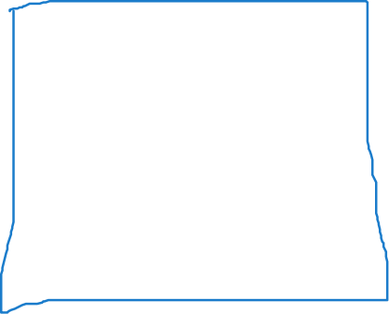







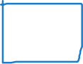





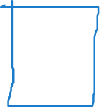


Pagination
Break Points
/*for desktop */
.col-1 { width: 8.33%; }
.col-2 { width: 16.66%; }
.col-3 { width: 25%; }
.col-4 { width: 33.33%; }
.col-5 { width: 41.66%; }
.col-6 { width: 50%; }
.col-7 { width: 58.33%; }
.col-8 { width: 66.66%; }
.col-9 { width: 75%; }
.col-10 { width: 83.33%; }
.col-11 { width: 91.66%; }
.col-12 { width: 100%; }
@media only screen and (max-width: 768px) {
/* For mobile phones: */
[class*="col-"] {
width: 100%;
}
}
Large device
Tabs device
android device

Slide 55
1. Design a complete web site with responsive layout and attractive content.
2.Design the w3schools home page .
Assignment 9:

Slide 56



Thanks
Good Luck for the next Part of Web development
Learn JavaScript

